Slide 1
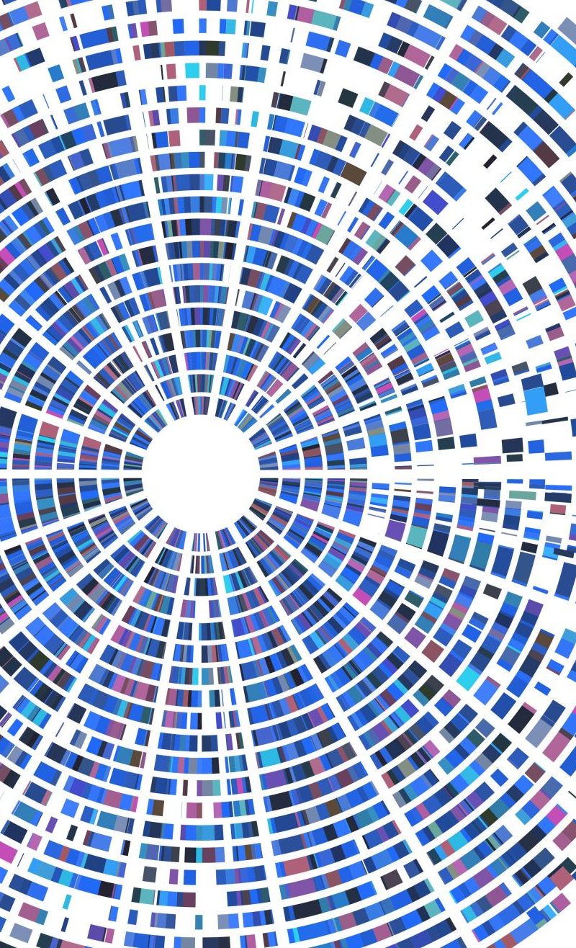
Agile Presentation
Marisa Kuyava

Slide 2
Team Roles
Product Owner
The Product Owner is responsible for maximizing the value of the product and the work of the Development Team. The Product Owner represents the business sponsor, is a decision maker for the project, provides direction to the team on what will be built, and prioritizes the work to be done. (Cobb 2015 Pg. 35)
Scrum Master
The Scrum Master is responsible for ensuring Scrum is understood and enacted. The Scrum Master is what is known in agile as a servant leader. He/she has the responsibility to facilitate the team. He/she is not expected to provide a significant amount of direction to the team as a project manager would—the team is supposed to be self-organizing and empowered so the role of the Scrum Master in providing direction is limited. (Cobb 2015 Pg. 36, 37)
Development Team
The Development Team consists of professionals who do the work of delivering a potentially releasable increment of “Done” product at the end of each Sprint. Only members of the Development Team create the increment. The team is expected to act as a single entity where all the members of the team act collaboratively and cohesively as a single unit. A team may consist of people with different specialties. For example there could be people who specialize in development on the team and others who specialize in testing. (Cobb 2015 Pg. 37, 38)

Slide 3
Phases of the SDLC Planning, Requirements and Design
Planning
There is a common misconception that agile projects are not planned at all. That is not the case, it is just a different kind of planning, and the planning is spread out over the project rather than attempting to do the majority of the planning upfront prior to the start of the project. Rolling-wave planning and progressive elaboration of requirements are both used to plan agile projects. The planning approach is very much related to the level of uncertainty in a project and the planning approach attempts to reduce the level of uncertainty to an acceptable level based on the nature and complexity of the project. The level of planning in an agile project can vary significantly depending on the project and it is always best to fit the planning approach to the nature of the project and the level of uncertainty associated with it. (Cobb 2015 Pg. 70)
Requirements
Prioritization of requirements is extremely important in an agile project and requires a spirit of trust and collaboration between the business users and the project team to work together to deliver the highest-value items first and to preserve simplicity of the solution and avoid going beyond what is needed to satisfy the fundamental business need. user persona is used in agile for personalizing user requirements; however, it really is a general process that can be used in any kind of development effort. User stories are a succinct way of defining requirements in agile. Telling user stories simplifies the definition of the requirements in a language that can be easily understood by both developers and users. It breaks the requirements into small chunks of functionality that can be built incrementally. User stories follow the general format: As a I want so that . An epic is a large user story (Cobb 2015 Pg. 70, 71)
Design
The product backlog is a very important tool in an agile project for maintaining a prioritized queue of project requirements. It should be dynamic and should be continuously groomed as the project progresses. Agile projects generally use an iceberg strategy for grooming the product backlog. The items that are near the top of the iceberg and are closest to going into development should get the most attention. There should typically be about two to three sprints worth of stories at the top of the backlog that are well-groomed and ready to go into development in order to avoid a situation where the project team is waiting for work to do. However, the product backlog grooming does not need to be limited to two to three sprints in advance, and it is a judgment call of how far it is reasonable to plan into the future (Cobb 2015 Pg. 71)

Slide 4
Phases of the SDLC Coding
Coding. (Cobb 2015 Pg. 81-2)
Continuous Integration and Code Refactoring An agile project calls for a different approach for managing the development process that should be well-integrated and well-aligned with the overall agile project management approach. It is not often possible to completely lay out and stabilize the design of a project early in the project. A more dynamic approach for evolving the design as the project progresses is needed. Because the design is potentially changing throughout the project, a rigorous approach is needed to manage how changes are merged into the design, emphasizing continuous integration and code refactoring to ensure that the overall reliability of the design is still maintained.
Pair programming is sometimes used in agile projects to coach and mentor less-experienced developers and to provide higher levels of code quality and reliability. However, it is difficult to justify the economics of pair programming on all agile projects, and sometimes a more limited form of code reviews can accomplish some of the same goals.
Test-driven development is often used on agile project to simplify the development effort and to improve the reliability and quality of the software.

Slide 5
Phases of the SDLC Unit and Acceptance Testing
Unit Testing and Acceptance Testing . (Cobb 2015 Pg. 83)
Instead of waiting until the end of the sprint to turn over all stories to QA for testing, a better practice would be to have the testers begin testing the software as soon as it is sufficiently complete for testing. That approach allows more concurrency of development and testing and avoids any last-minute surprises at the end of the sprint.
Acceptance test-driven development is very similar to test-driven development, but it is at a higher level of functionality. A big advantage of acceptance test-driven development is that it can eliminate the requirement for writing detailed functional specifications, it simplifies the requirements definition process, and it keeps everyone on the team clearly focused on the functionality that must be provided to satisfy the business need.
Because testing is done concurrently with development in an agile project and new functionality is being continuously added, it is essential for tests to be repeatable in an agile project to ensure that new functionality or other development activity has not broken something that was already tested and completed. As agile projects get larger, there is a big advantage to automating regression tests so that they can be run repeatedly and efficiently on a frequent basis. In an ideal case, automated regression tests can be run nightly to check the entire system as new functionality is being added.
Testing It is impossible to test everything. Fortunately, an agile project makes that easier to determine what is important, and the user is directly engaged in testing the functionality of the software as it is being developed.

Slide 6
Waterfall vs. Agile
Waterfall
The waterfall model describes a development method that is linear and sequential. Waterfall development has distinct goals for each phase of development. Imagine a waterfall on the cliff of a steep mountain. Once the water has flowed over the edge of the cliff and has begun its journey down the side of the mountain, it cannot turn back. It is the same with waterfall development. Once a phase of development is completed, the development proceeds to the next phase and there is no turning back. (Cobb 2015 Pg. 4)
Agile
Scrum is an agile software development model based on multiple small teams working in an intensive and interdependent manner. The term is named for the scrum (or scrummage) formation in rugby, which is used to restart the game after an event that causes play to stop, such as an infringement. Scrum employs real-time decision-making processes based on actual events and information. (Cobb 2015 Pg. 5)
Utilizing the Agile approach save time and money on the SNHU Travel project and was the most appropriate approach due to the uncertainly, and eventually the changes to the project requirements. If was had utilized the Waterfall approach when the client pivoted from one format to another or the types of travel they wanted to promote the project would have needed a full restart.

Slide 7
Agile
Waterfall
or
Pros | Cons | Pros | Cons
Simple and easy to understand and use | High amounts of risk and uncertainty. | Little or no planning required. | More risk of sustainability, maintainability and extensibility.
Easy to manage due to the rigidity of the model. | Poor model for long and ongoing projects. | Promotes teamwork and cross training. | Not suitable for handling complex dependencies.
Phases are processed and completed one at a time. | Not suitable for the projects where requirements are at a moderate to high risk of changing. | Suitable for fixed or changing requirements | Depends heavily on customer interaction, so if customer is not clear, team can be driven in the wrong direction.
Works well for smaller projects where requirements are very well understood | Poor model for long and ongoing projects. | Enables concurrent development and delivery within an overall planned context. | Strict delivery management dictates the scope, functionality to be delivered, and adjustments to meet the deadlines.
Process and results are well documented. | No working software is produced until late during the life cycle. | Functionality can be developed rapidly and demonstrated. | Transfer of technology to new team members may be quite challenging due to lack of documentation.
There are many factors to consider when choosing between the waterfall and agile approach as shown above, each has pros and cons. However, when determining what approach to take I believe the largest factors are how certain the requirements are and how long the project will take to be completed. In most situation I believe that Agile will be the most efficient and effective methodology to follow.
Pros and Cons taken from SDLC Tutorial https://www.tutorialspoint.com/sdlc/sdlc_agile_model.htm

Slide 8
References
Charles G. Cobb. (2015). The Project Manager’s Guide to Mastering Agile : Principles and Practices for an Adaptive Approach. Wiley.
SDLC tutorial. https://www.tutorialspoint.com/sdlc/index.htm.

